Slide 1
Interpolation Search
By Kaleb Bartholomew & Nicholas Dobard

Slide 2

Brief Review of Interpolation Search
An algorithm designed for searching for a key over an ordered array. (this works best with large data sets)
Algorithm uses a “probed” result to “guess” the value’s location based and then narrowing the search area and calculating a new probe
Typically done via Linear Interpolation.
A method of curve fitting using linear polynomials to construct new data points within the range of a discrete set of known data points.
Calculating the probable position of the target value is based on the value range (y) and their distribution (x).
The algorithm then narrows down the remaining search space until the target value is located, or the search ranges becomes empty.
Described by W. W. Peterson in 1975.
American Computer Scientist & Mathematician

Slide 3
Interpolation vs Linear Regression
Interpolation and linear regression are two distinct mathematical techniques used for different purposes, but they both involve estimating values based on a given dataset.
Purpose (Interpolation then Linear Regression)
Estimates an unknown value within the range of a given dataset by constructing a curve or function that passes through the data points.
Finds the best-fitting linear equation (straight line) that describes the relationship between a dependent variable and one or more independent variables.
Assumptions
Interpolation assumes that the data is accurate and complete, and that the curve or function constructed accurately represents the underlying phenomenon.
Linear regression assumes that there is a linear relationship between the dependent and independent variables, and that the residuals (errors) are normally distributed and independent of each other.

Slide 4
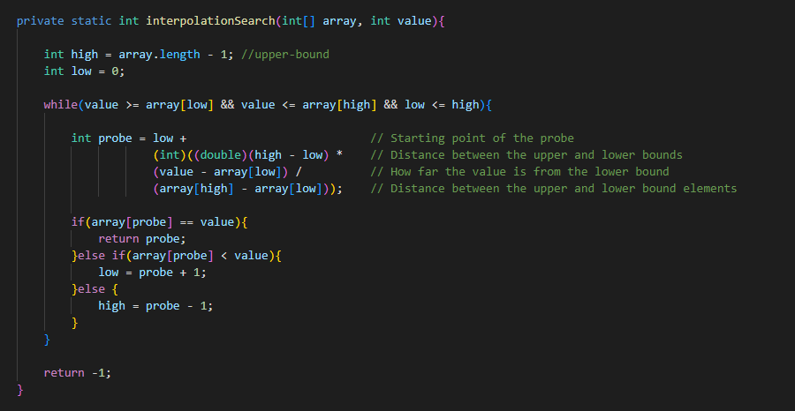
Algorithm Overview
Purpose: Efficiently search for a value in a sorted array
Basic idea: Estimate the position of the value using interpolation
Key Points
Initializes High & Low Bounds
While value is within the range and low <= high:
A. Calculate probe using interpolation formula
B. Compare array[probe] to the given value
C. Update low or high based on the comparison
Returns the index of the value or -1 of not found

Slide 5
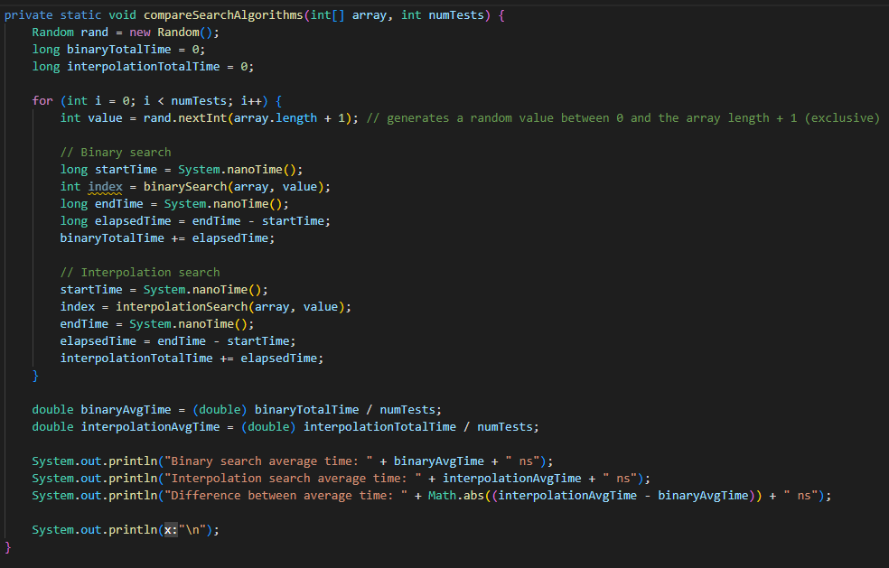
Comparing Search Algorithms
compareSearchAlgorithms
Purpose: Compare the performance of binary and interpolation search algorithms
Method: Execute both algorithms multiple times and calculate average time taken
Key components:
numTests: Number of tests to perform
Random: Generate random search values
binaryTotalTime: Accumulate binary search time
interpolationTotalTime: Accumulate interpolation search time

Slide 6
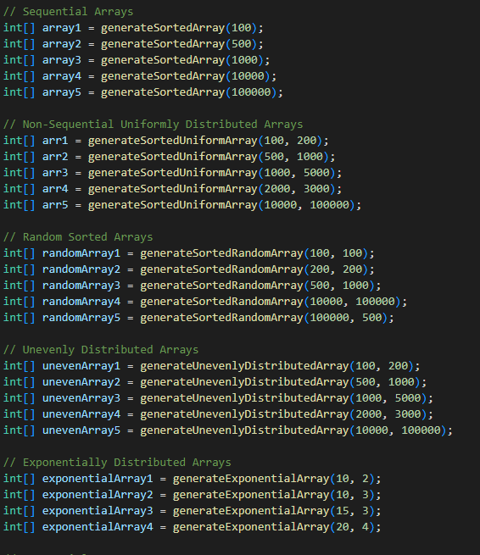
Data Distributions
Because its heavily implied interpolation search works the best with uniformly distributed data In order to cover all our bases we decided to
Array Generation Algorithms
generateSortedArray
Purpose: Generate an array of ascending numbers
generateSortedUniformArray
Purpose: Generate a uniformly distributed sorted array
generateSortedRandomArray
Purpose: Generate a sorted array of random integers
generateUnevenlyDistributedArray
Purpose: Generate a sorted array with uneven distribution
generateExponentialArray
Purpose: Generate an exponential array

Slide 7
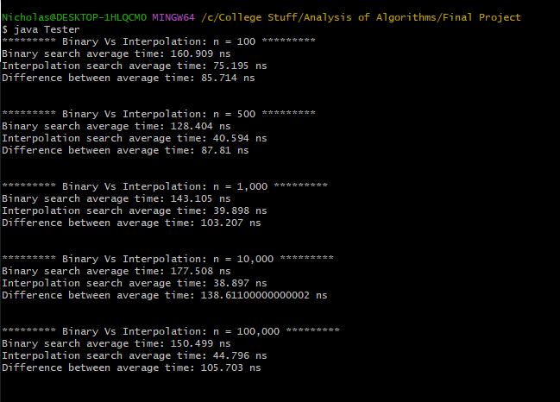
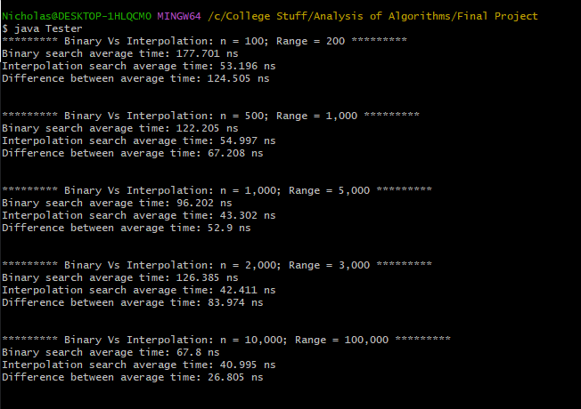
Data

Slide 8
Uniformal Graphs

Slide 9
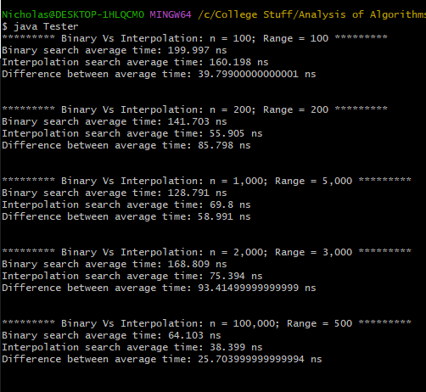
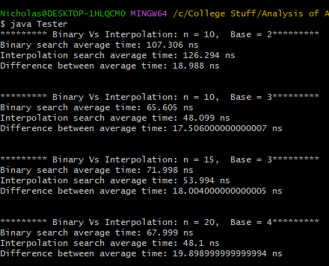
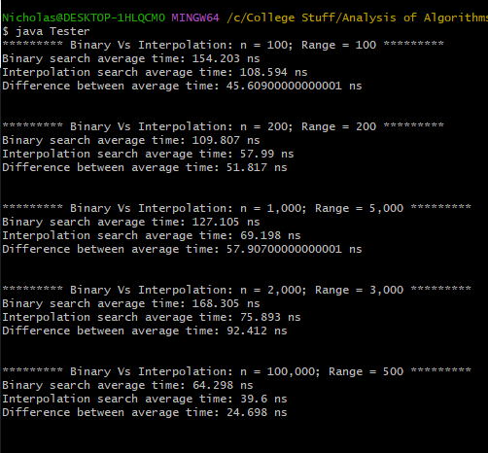
Data

Slide 10
Non-Uniformal Graphs

Slide 11
Exponential Non-Uniformal Graphs

Slide 12
Runtime O(log(log n)
In each iteration, interpolation search reduces the search space by a factor determined by the distribution of the data in the array.
The number of iterations required to find the target value can be expressed as the number of times the search space can be reduced by this factor. This is equivalent to taking the logarithm (base 2) of the array size, which is log(n).
The O(log(log n)) complexity comes from the fact that the reduction factor is not constant, but rather depends on the distribution of the data. In the best-case scenario, the reduction factor is proportional to log(n). Therefore, the number of iterations required is log(log n).
the Algorithm assumes the data in a given array is uniformly distributed.
Under this assumption, the probability of the estimated position being close to the target value is high, which means that the algorithm can converge quickly.

Slide 13

Calculating Big O
Because the algorithm is designed such that the range decreases with each probe the algorithm should never search more than the number of values in the array meaning the worst runtime is O(N).
Assuming your data is uniformly distributed. The number of iterations required is proportional to the logarithm of the logarithm of the array size, i.e., log(log(n)) which represents the average runtime. This is an approximation, and the actual complexity can vary depending on the specific distribution of the data in the array.
If the target value is found in the first probe (i.e., the estimated position is correct), the complexity is O(1), which represents a constant time complexity.

Slide 14

Work Distribution
PowerPoint 70/30 Kaleb did the slides Nicholas provided the data
K: Research on Interpolation and Interpolation Search 70/30
N: Implementation of Interpolation Search 80/20
We reviewed each others work as we went along

Slide 15
EL FIN
Floor is now open to questions

